Slide 1
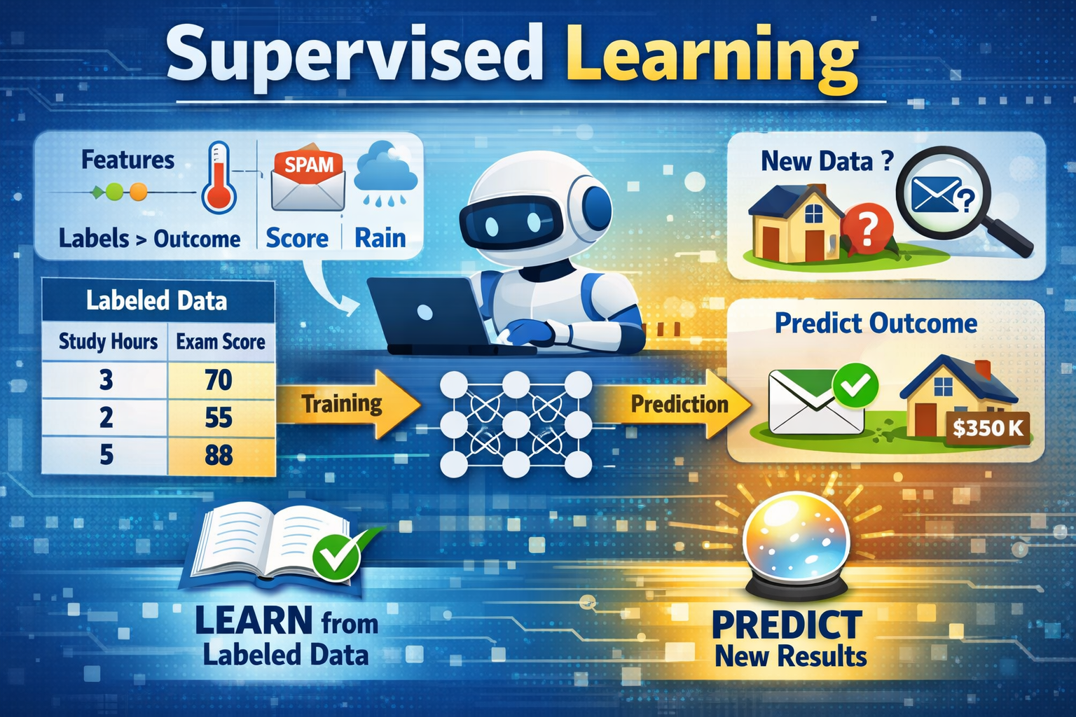
SUPERVISED LEARNING
Dr Ashok Gopalakrishnan
Scientist Emeritus
Retired from NASA
ICON of UIT-Coimbatore

Slide 2
SUPERVISED LEARNING
Supervised learning is a type of machine learning where a model is trained using labeled data. This means that for every input (features), there is a corresponding correct output (label). The model learns to map inputs to outputs by minimizing the error between its predictions and the actual labels. Once trained, the model can make predictions on new, unseen data.
For example, a supervised learning model trained on images of handwritten digits (with labels indicating the correct digit) can recognize new digits it has never seen before.
Key Types of Supervised Learning
Classification: The goal is to predict categorical outputs (e.g., spam vs. non-spam emails, cancerous vs. non-cancerous cells). Example: Email spam detection, where the model classifies emails as "spam" or "not spam."
Regression: The goal is to predict continuous numerical outputs (e.g., house prices, stock prices). Example: Predicting house prices based on features like size, location, and number of rooms.

Slide 3
SUPERVISED LEARNING
Examples of Supervised Learning in Real Life
Email Spam Detection: Models are trained on labeled emails (spam or not spam) to identify spam emails.
Disease Diagnosis: Medical images labeled as "disease present" or "disease absent" are used to train models for diagnosis.
Stock Price Prediction: Historical stock data is used to predict future stock prices.
Customer Churn Prediction: Telecom companies use customer behavior data to predict whether a customer will leave their service.
Fraud Detection: Banks use transaction data labeled as "fraudulent" or "legitimate" to detect fraud patterns.

Slide 4
SUPERVISED LEARNING
Common Algorithms in Supervised Learning
Linear Regression: Predicts continuous values by finding a linear relationship between inputs and outputs.
Logistic Regression: Used for binary classification tasks like spam detection.
Decision Trees: Models decisions and their possible outcomes in a tree-like structure.
Random Forests: Combines multiple decision trees to improve accuracy and reduce overfitting.
Support Vector Machines (SVM): Creates a hyperplane to separate data into classes or predict continuous values.
K-Nearest Neighbors (KNN): Predicts outputs based on the closest data points in the training set.
Naive Bayes: Assumes feature independence and is commonly used for text classification tasks like sentiment analysis.

Slide 5
SUPERVISED LEARNING
Advantages of Supervised Learning
High Accuracy: Produces reliable predictions when trained on sufficient labeled data.
Versatility: Applicable to both classification and regression problems.
Wide Applications: Used in fields like healthcare, finance, and marketing.
Challenges of Supervised Learning
Data Dependency: Requires large amounts of labeled data, which can be expensive and time-consuming to prepare.
Overfitting: Models may memorize training data instead of learning general patterns, especially with small datasets.
Bias: If the training data is biased, the model may amplify these biases in predictions.

Slide 6
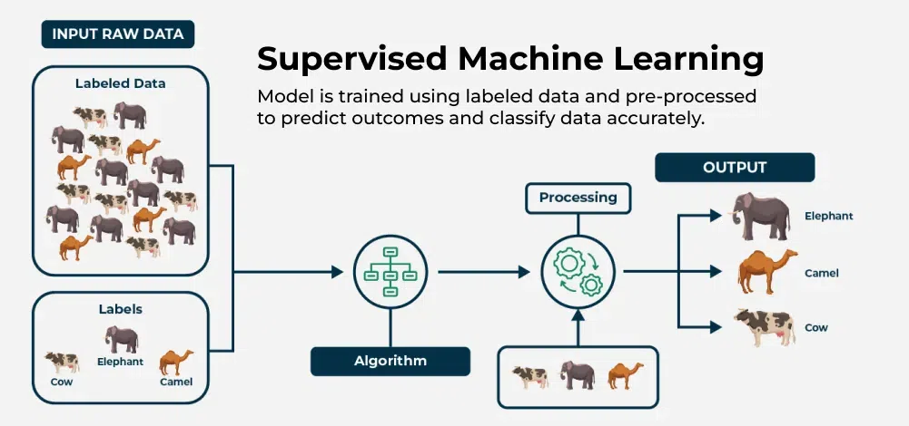
SUPERVISED LEARNING

Slide 7
SUPERVISED LEARNING
Its main features are:
Each input has a known output
Adjusts itself to reduce prediction errors
Make accurate predictions on new data
For example in recognizing handwritten digits from trained data
Types of Supervised Learning
Now, Supervised learning can be applied to two main types of problems:
Classification: Where the output is a categorical variable (e.g., spam vs. non-spam emails, yes vs. no).
Regression: Where the output is a continuous variable (e.g., predicting house prices, stock prices).

Slide 8
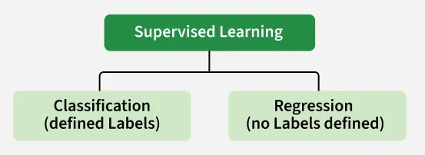
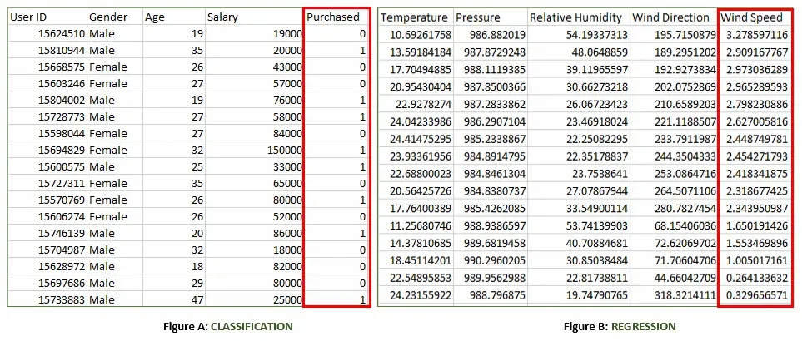

Slide 9
SUPERVISED LEARNING
Figure A: It is a dataset of a shopping store that is useful in predicting whether a customer will purchase a particular product under consideration or not based on his/her gender, age and salary.
Input: Gender, Age, Salary
Output: Purchased i.e. 0 or 1; 1 means yes the customer will purchase and 0 means that the customer won't purchase it.
Figure B: It is a Meteorological dataset that serves the purpose of predicting wind speed based on different parameters.
Input: Dew Point, Temperature, Pressure, Relative Humidity, Wind Direction
Output: Wind Speed

Slide 10
SUPERVISED LEARNING
Working of Supervised Machine Learning
1. Collect Labeled Data
Gather a dataset where each input has a known correct output (label).
Example: Images of handwritten digits with their actual numbers as labels.
2. Split the Dataset
Divide the data into training data (about 80%) and testing data (about 20%).
The model will learn from the training data and be evaluated on the testing data.
3. Train the Model
Feed the training data (inputs and their labels) to a suitable supervised learning algorithm (like Decision Trees, SVM or Linear Regression).
The model tries to find patterns that map inputs to correct outputs.

Slide 11
SUPERVISED LEARNING
Working of Supervised Machine Learning
4. Validate and Test the Model
Evaluate the model using testing data it has never seen before.
The model predicts outputs and these predictions are compared with the actual labels to calculate accuracy or error.
5. Deploy and Predict on New Data
Once the model performs well, it can be used to predict outputs for completely new, unseen data.

Slide 12
SUPERVISED LEARNING
Algorithm: Linear Regression (Supervised Learning)
Step-by-Step in Simple Terms
Start with data you already know. You have examples where both the input and output are known — like how many hours a student studied and what score they got. Example:
2 hours → 50 marks
4 hours → 60 marks
6 hours → 70 marks
Guess a straight line. You assume there’s a line that connects study hours to marks. The line looks like: Predicted Marks = (Slope × Hours) + Intercept
Check how good your guess is. You compare your predicted marks with the real marks. The difference between them is called error.
Adjust the line to reduce the error. You keep tweaking the slope and intercept so that the line fits the data better. This process is called training — the computer learns the best line by minimizing the error.
Stop when the line fits well. When changes no longer improve accuracy much, you stop adjusting. Now you have your final model — the best‑fit line.
Use the line to predict new results. If a new student studies 7 hours, you plug it into your line: Predicted Marks = (Slope × 7) + Intercept That gives you the expected score.

Slide 13
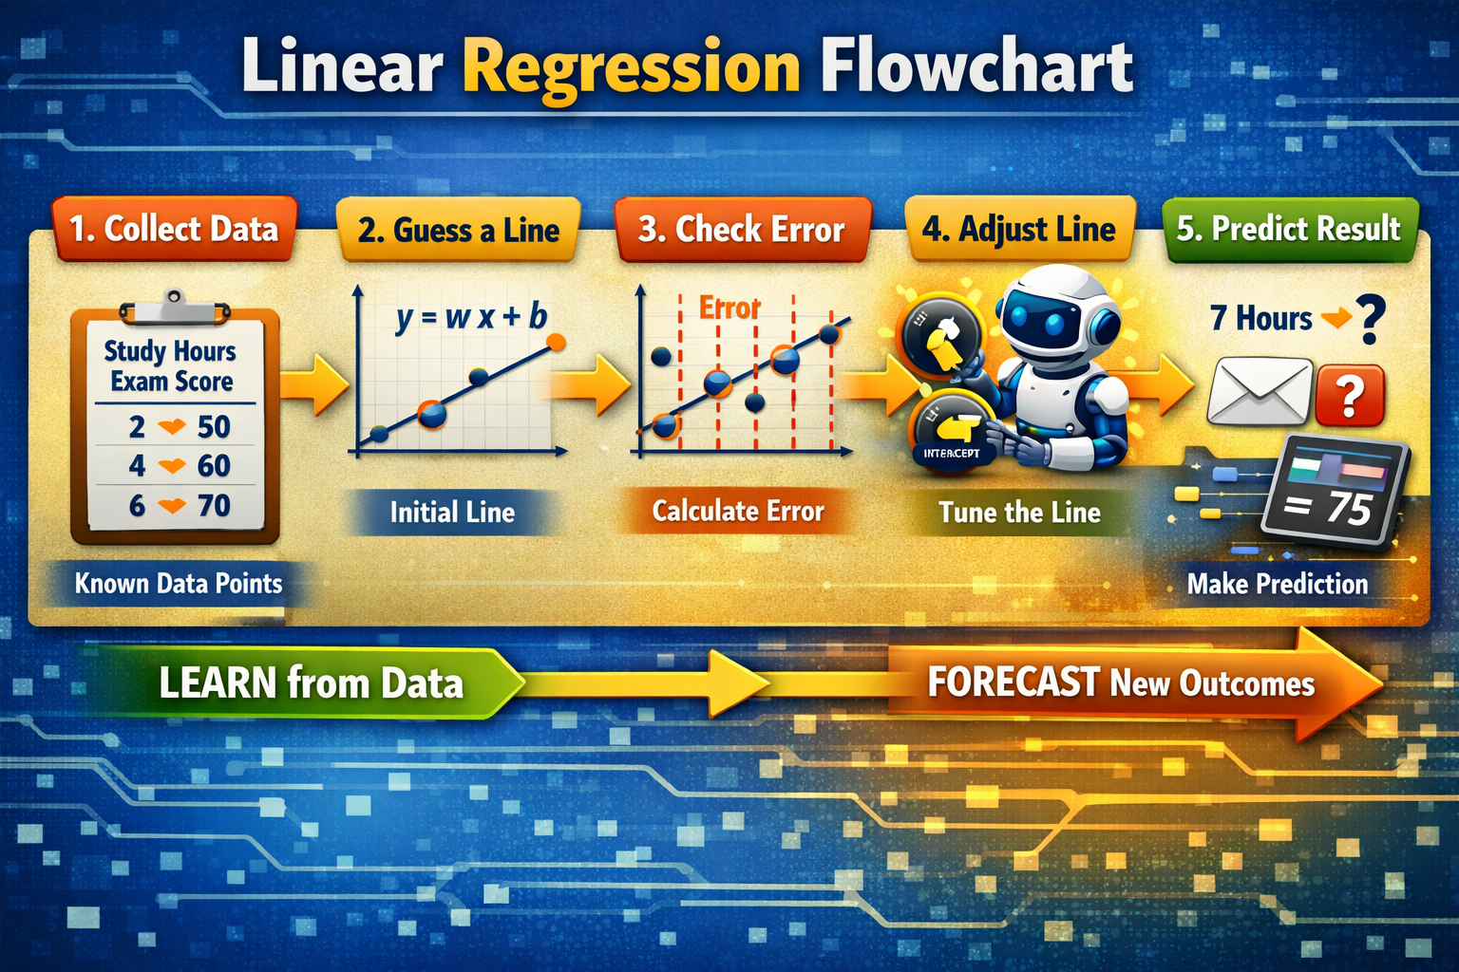
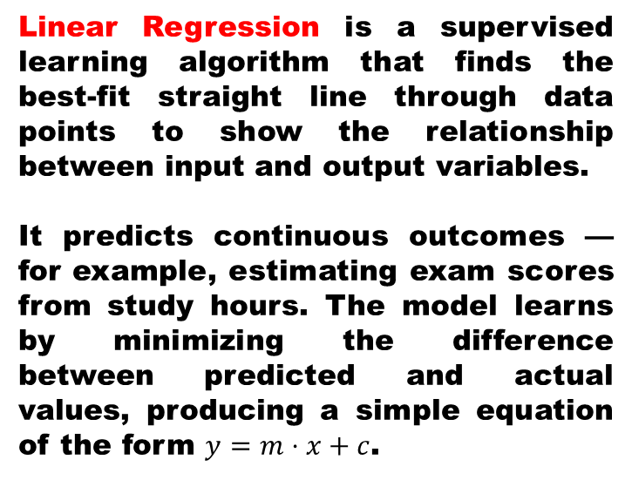
SUPERVISED LEARNING
Collect Data → Gather examples (study hours → exam scores).
Guess a Line → Draw an initial straight line through the data.
Check Error → Measure how far the line is from the actual points.
Adjust Line → Tweak slope and intercept to reduce error.
Predict Result → Use the final line to forecast new outcomes.
Linear Regression is a supervised learning algorithm that finds the best‑fit straight line through data points to show the relationship between input and output variables.
It predicts continuous outcomes — for example, estimating exam scores from study hours. The model learns by minimizing the difference between predicted and actual values, producing a simple equation of the form $y=m⋅x+c$.

Slide 14
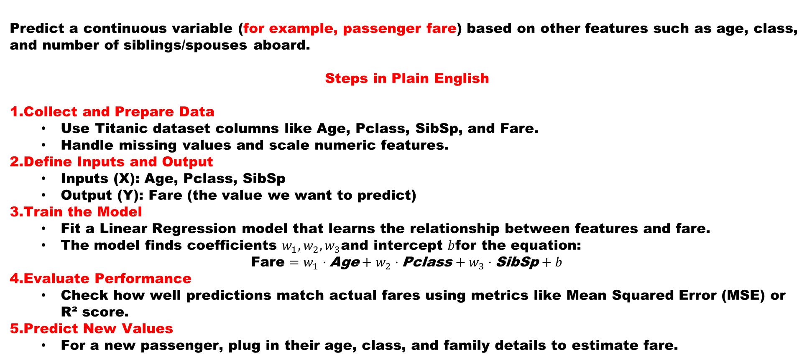
SUPERVISED LEARNING
Linear Regression — Titanic Dataset Example
Predict a continuous variable (for example, passenger fare) based on other features such as age, class, and number of siblings/spouses aboard.
Steps in Plain English
Collect and Prepare Data
Use Titanic dataset columns like Age, Pclass, SibSp, and Fare.
Handle missing values and scale numeric features.
Define Inputs and Output
Inputs (X): Age, Pclass, SibSp
Output (Y): Fare (the value we want to predict)
Train the Model
Fit a Linear Regression model that learns the relationship between features and fare.
The model finds coefficients $w_{1},w_{2},w_{3}$and intercept $b$for the equation:
$$\text{Fare}=w_{1}⋅\text{Age}+w_{2}⋅\text{Pclass}+w_{3}⋅\text{SibSp}+b$$
Evaluate Performance
Check how well predictions match actual fares using metrics like Mean Squared Error (MSE) or R² score.
Predict New Values
For a new passenger, plug in their age, class, and family details to estimate fare.

Slide 15
SUPERVISED LEARNING
Linear Regression — Titanic Dataset Example
Use a small sample (say 10 passengers) to show how the line of best fit changes when you add or remove features. Students can visualize how continuous prediction differs from classification (e.g., survival).
A sample running code in Python has been sent to IICT for your reference using sklearn for
Linear Regression Kindly ask for it
Here’s a ready‑to‑use Jupyter Notebook template my students can run to experience both
Supervised and Unsupervised Learning on the Titanic dataset side by side. It’s simple, commented,
and designed for beginners:
Python demo snippet for Logistic Regression on the Titanic dataset, showing how classification
differs from regression. Understand these 2 programs first and then use them to write your code.
NOTE: The above 3 programs have been sent to IICT. All programs are executable. Make appropriate
changes and run. The date for submission of all exercises will be given on the last day of theory
Along with the submission details. Marks will be allocated accordingly

Slide 16
Unsupervised Learning is a type of machine learning where the model learns patterns and relationships from data without any labeled outputs or predefined answers. It explores the structure of the data on its own — grouping similar items or finding hidden patterns.
It’s like giving the computer a pile of mixed objects and asking it to organize them by similarity, without telling it what each object is.
Common Techniques
Clustering: Grouping similar data points (e.g., customer segmentation, galaxy clusters).
Dimensionality Reduction: Simplifying data while preserving important information (e.g., PCA for visualization).
In the Titanic dataset, unsupervised learning could group passengers into clusters based on age, class, and fare — revealing natural patterns like “young travelers in 3rd class” or “wealthy families in 1st class.”

Slide 17
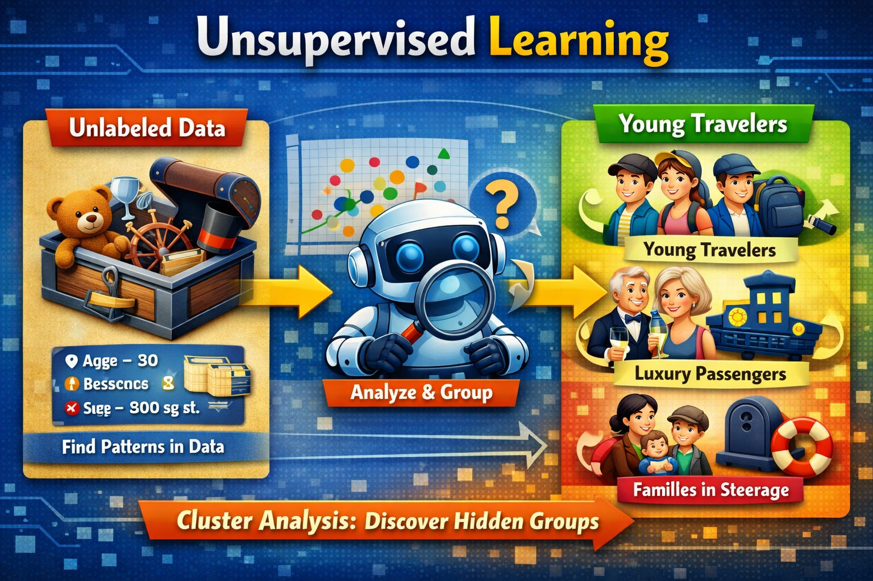
Left (Unlabeled Data): Shows that the computer receives raw, mixed data without any labels or categories.
Center (Robot with Magnifier): The model analyzes patterns and similarities among data points.
Right (Clusters): It groups similar items — for example, Titanic passengers forming clusters like Young Travelers, Luxury Passengers, and Families in Steerage.

Slide 18
Supervised vs. Unsupervised Learning visual will look —
keeping the Titanic dataset theme consistent
Aspect | Supervised Learning | Unsupervised Learning
Data Type | Labeled (inputs with known outputs) | Unlabeled (no predefined answers)
Example (Titanic) | Predicting Survival or Fare using features like age, class, and sex | Grouping passengers into clusters like Luxury Travelers, Families in Steerage, Young Adventurers
Goal | Learn from examples to predict outcomes | Discover hidden patterns or natural groupings
Algorithms | Linear Regression, Logistic Regression, Decision Trees | K‑Means, Hierarchical Clustering, PCA
Output Type | Continuous or categorical prediction | Clusters or reduced dimensions
Analogy | A student learning with an answer key | A student exploring patterns without guidance

Slide 19
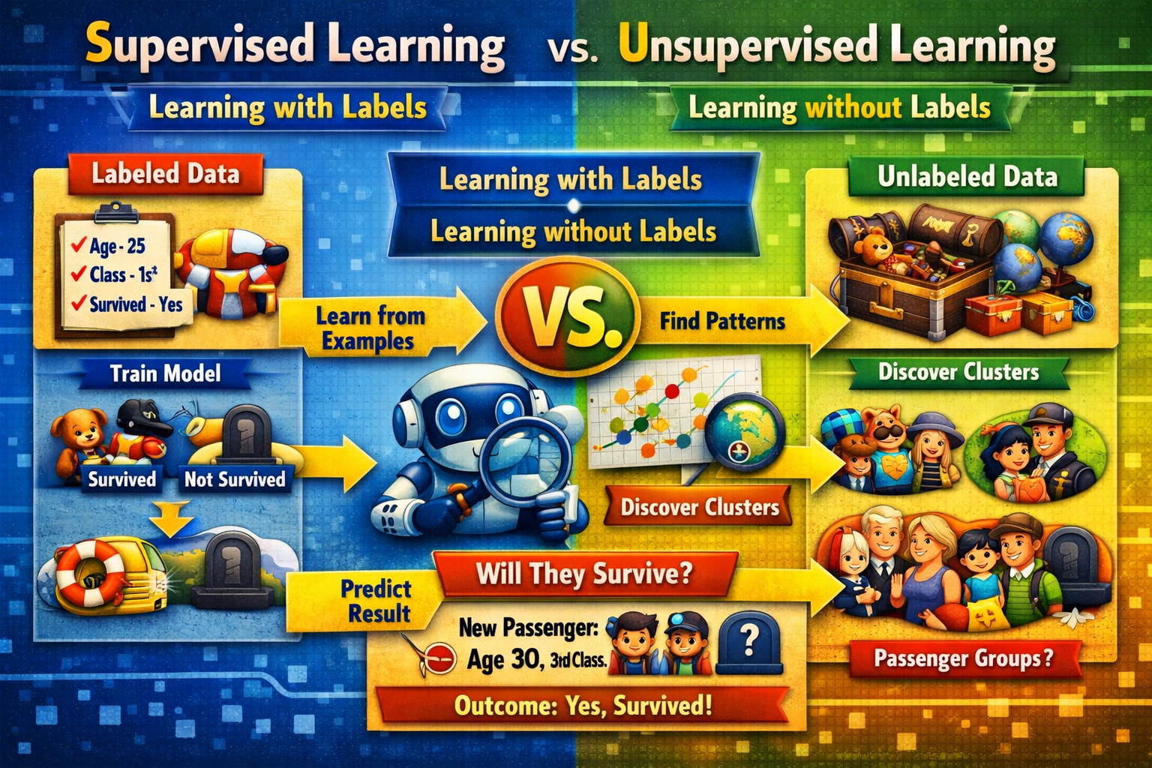
Supervised vs. Unsupervised Learning comparison infographic — themed around the Titanic dataset

Slide 20
Titanic Learning Lab: Supervised vs. Unsupervised
Objective
Students will:
Apply Logistic Regression to predict survival (Supervised Learning).
Apply K‑Means Clustering to group passengers (Unsupervised Learning).
Compare results and interpret insights.
Part 1 – Supervised Learning (Logistic Regression)
Goal: Predict whether a passenger survived.
Steps:
Load Titanic dataset.
Select features: Age, Pclass, Sex.
Encode categorical data (Sex: male = 0, female = 1).
Split data into training and testing sets.
Train a Logistic Regression() model.
Evaluate accuracy and confusion matrix.
Predict survival for a new passenger (e.g., Age = 30, Pclass = 3, Sex = female).
Expected Output:
Accuracy score (≈ 75–80%)
“Predicted Survival: Yes/No”

Slide 21
Titanic Learning Lab: Supervised vs. Unsupervised
Part 2 – Unsupervised Learning (K‑Means Clustering)
Goal: Group passengers by similarity.
Steps:
Use features: Age, Fare, Pclass.
Handle missing values.
Apply KMeans(n_clusters=3) to find natural groups.
Visualize clusters using a scatter plot (Age vs. Fare).
Label clusters manually (e.g., Luxury Travelers, Families in Steerage, Young Adventurers).
Expected Output:
Cluster centers (average Age, Fare, Class)
Visualization showing distinct passenger groups

Slide 22
Titanic Learning Lab: Supervised vs. Unsupervised
Part 3 – Compare & Reflect
Aspect | Supervised Learning | Unsupervised Learning
Data Type | Labeled (Survived = Yes/No) | Unlabeled (no survival info)
Goal | Predict outcome | Discover patterns
Algorithm | Logistic Regression | K‑Means Clustering
Output | Survival prediction | Passenger clusters
Learning Style | Guided by known answers | Self‑organizing
Ask students:
How does having labels change the learning process?
What insights do clusters reveal that predictions cannot?
How might both methods complement each other in real‑world analysis?

Slide 23
Unsupervised Machine learning algorithms explore data by looking for structures or patterns. The primary goal is to model the underlying structure or distribution of the data to learn more about the data. These algorithms are particularly useful for exploratory data analysis, dimensionality reduction, and discovering hidden patterns within data.
There are two main types of unsupervised learning: clustering and association. Clustering algorithms group a set of objects in such a way that objects in the same group (called a cluster) are more similar to each other than to those in other groups. Association rule learning, on the other hand, is a rule-based machine learning method for discovering interesting relations between variables in large databases.
Astronomy (classifying galaxies, identifying star clusters): Unsupervised learning allows the analysis of huge sets of astronomical objects, where galaxies are classified or clusters of stars are detected that have the same properties.
Climate Science (grouping weather patterns): Unsupervised learning can make weather patterns into different regimes, thus, it will facilitate the researchers in the study of climate variations.

Slide 24
Machine learning best practices
Across both approaches, several practices consistently improve outcomes:
Ensure high-quality input data, including proper handling of missing values and outliers
Start with a clear problem definition before selecting an approach
Implement data quality checks and validation processes early
Use appropriate evaluation metrics for each paradigm
Begin with exploratory data analysis before committing to production workflows

Slide 25
What you need to know in 2026
Self-supervised pretraining now underpins most modern foundation models
Most state-of-the-art models — including large language models, computer vision systems and multimodal architectures — are now trained primarily using self-supervised learning. Rather than relying on human-labeled datasets, these models generate their own training signals from raw data, such as predicting the next token in a sequence or reconstructing masked portions of an input.
This shift reflects a practical reality: enterprises possess vast amounts of unlabeled data, but labeling at scale is costly and slow. Self-supervised learning allows organizations to extract value from existing data assets while building representations that can later be adapted to specific tasks.

Slide 26
What you need to know in 2026
2. Supervised fine-tuning has moved into a refinement role
Supervised learning has not disappeared — but its role has changed. Instead of serving as the primary training mechanism, supervised fine-tuning is increasingly used to refine, align and validate models for well-defined business objectives.
This approach enables teams to focus labeling efforts where precision matters most, such as regulatory requirements, safety constraints or domain-specific accuracy, while avoiding unnecessary labeling earlier in the pipeline.

Slide 27
What you need to know in 2026
3. Embeddings are now core enterprise capabilities
Embeddings have become core enterprise infrastructure. Foundation models increasingly output vector embeddings that capture semantic meaning across text, images, audio, and structured data. These embeddings power similarity search, retrieval, personalization, anomaly detection, and recommendation systems at scale.
Clustering and other similarity-based methods are important—but they are downstream applications of embeddings rather than peer paradigms. The strategic shift is not toward clustering itself, but toward embedding-centric architectures that enable unified search, retrieval, and reasoning across enterprise data.
As organizations operationalize AI, embeddings become connective tissue between self-supervised pretraining, supervised fine-tuning, and downstream applications. They provide a common representational layer that supports both exploration and precision workflows within modern, unified data platforms.

Slide 28
What you need to know in 2026
3. Build systems, not sides
Supervised and unsupervised learning solve different problems — and modern ML systems need both. Supervised machine learning excels when you have labeled data and need precise, accountable predictions or classifications. Unsupervised machine learning thrives when the goal is discovery, helping teams uncover patterns and insights in raw data without predefined outputs. When labeled data is limited, semi supervised learning approaches bridge the gap by combining both paradigms. The real challenge is not choosing between supervised vs unsupervised learning, but building systems that can combine approaches, evolve over time and operate reliably in production. Effective teams start by assessing their data availability, clarifying whether their primary goal is prediction or exploration, and evaluating the resources required to support each approach.
Machine learning strategies are rarely static. Unsupervised exploration often informs later supervised model development, while supervised fine-tuning brings precision and validation to systems built on broader representations. Over time, insights must flow into business intelligence and analytics where they can inform decisions and drive outcomes.

Slide 29
Supervised methods like Linear Regression and Logistic Regression help us answer practical questions: How much will this cost? Will this passenger survive? They thrive when we have historical data with outcomes clearly marked. In contrast, unsupervised methods like K‑Means clustering or PCA reveal natural groupings and simplify complexity, helping us discover patterns we didn’t know existed.
Together, these approaches form the backbone of modern AI. They are not competing philosophies but complementary tools — prediction and discovery working hand in hand. In the Titanic dataset, supervised learning predicts survival, while unsupervised learning uncovers passenger clusters. In real‑world applications, both perspectives enrich our understanding and decision‑making.
As you continue exploring machine learning, remember: the real power lies not just in algorithms, but in how we apply them to illuminate data, solve problems, and inspire new questions. Supervised or unsupervised, each step brings us closer to turning information into insight — and insight into impact

Slide 30
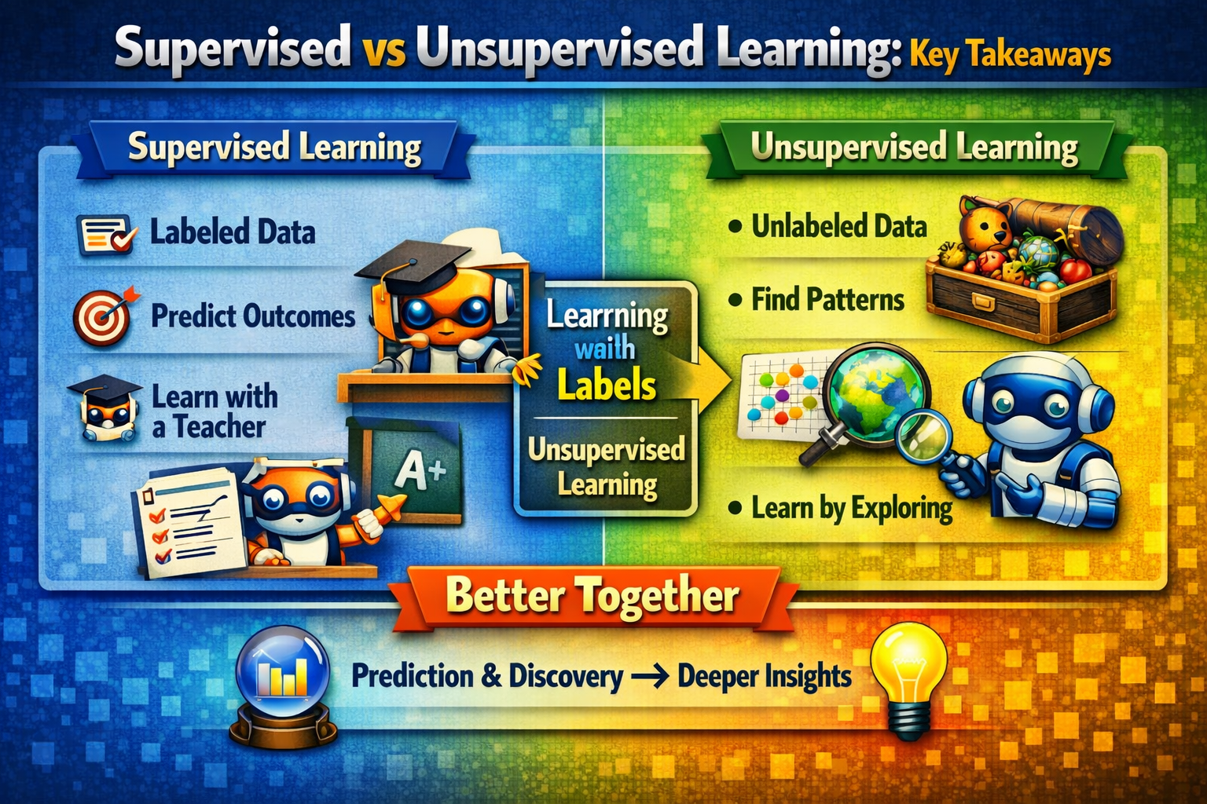
"Whether guided by labels or driven by exploration, machine learning helps us transform raw data into meaningful insight. The real impact comes when we combine both approaches — predicting what we know, and discovering what we don’t."
“Supervised learning teaches us from what we know; unsupervised learning reveals what we don’t. When we combine both, we move from data to understanding — and from understanding to innovation.”

Slide 31
Core Idea Machine learning learns from data in two ways — with guidance and without guidance.
Supervised Learning: Uses labeled data to predict outcomes.
Unsupervised Learning: Uses unlabeled data to discover hidden patterns.
Key Algorithms
Supervised → Linear Regression, Logistic Regression, Decision Trees.
Unsupervised → K‑Means, Hierarchical Clustering, PCA.
Titanic Example
Supervised: Predict survival chances using age, class, and gender.
Unsupervised: Cluster passengers into natural groups — Luxury Travelers, Families in Steerage, Young Adventurers.
Takeaway Message: Both approaches complement each other — prediction meets discovery. Together, they help us transform raw data into insight, and insight into impact.

Slide 32


